Slide 1
Efficient Feature Selection via Analysis of Relevance and Redundancy
A New Framework of Efficient Feature Selection
Presented by:
Alyakaev Kamil
Ushakov Stanislav

Slide 2
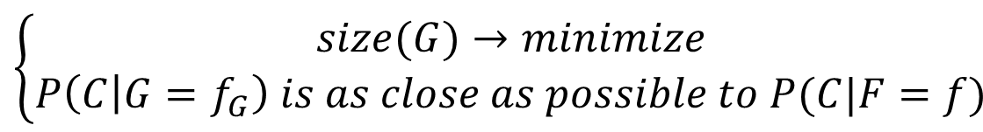
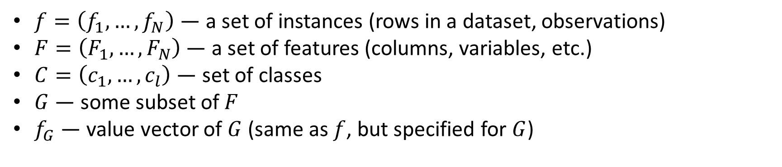
Variables
$f=\left(f_{1},…,f_{N}\right)$ — a set of instances (rows in a dataset, observations)
$F=\left(F_{1},…, F_{N}\right)$ — a set of features (columns, variables, etc.)
$C=\left(c_{1},…, c_{l}\right)$ — set of classes
$G$ — some subset of $F$
$f_{G}$ — value vector of $G$ (same as $f$, but specified for $G$)
Formal goal
$$\left\{\begin{aligned}size(G)→minimize \\ P\left(C | G=f_{G}\right) is as close as possible to P(C|F=f)\end{aligned}\right.$$

Slide 3
Complications
Measuring goodness of feature subsets:
Wrapper (iterative) model — computationally expensive
Filter (statistical) model — relies on many measures
More features:
Slower learning
Over-fitting
Irrelevant data
Number of possible feature subsets grows exponentially — going through them takes a lot of time
Main idea: exclude redundant data as well

Slide 4
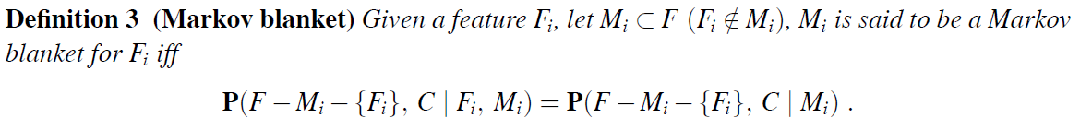
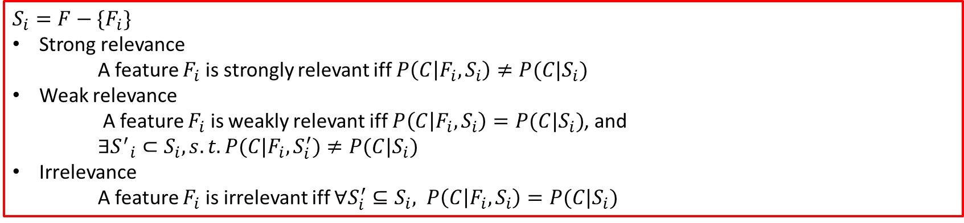
Relevance related definitions
$$S_{i}=F−\{F_{i}\}$$
Strong relevance
A feature $F_{i}$ is strongly relevant iff $P\left(C | F_{i},S_{i}\right)≠P(C|S_{i})$
Weak relevance
A feature $F_{i}$ is weakly relevant iff $P\left(C | F_{i},S_{i}\right)=P(C|S_{i})$, and
$∃{S^{′}}_{i}⊂S_{i}, s.t. P(C|F_{i},S_{i}^{′})≠P(C|S_{i})$
Irrelevance
A feature $F_{i}$ is irrelevant iff $∀S_{i}^{′}⊆S_{i}, P\left(C | F_{i},S_{i}\right)=P(C|S_{i})$

Slide 5
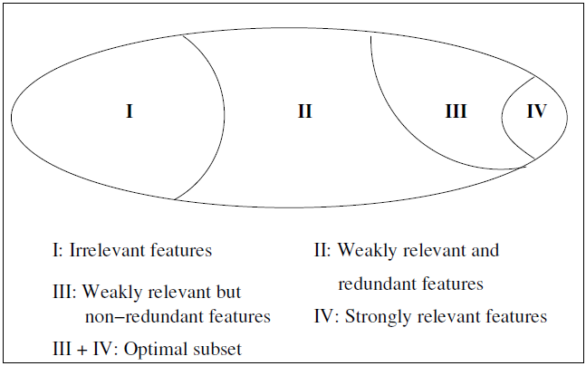
Feature gradation

Slide 6
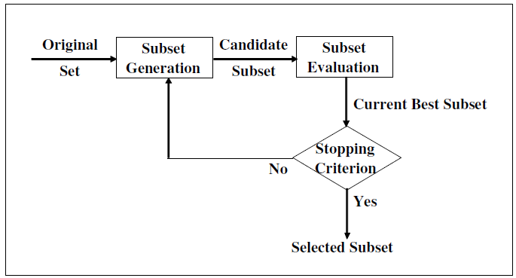
Existing and new approaches
Original
Set
Relevance
Analysis
Relevant
Subset
Redundancy
Analysis
Selected
Subset
Existing
New

Slide 7





Correlation measures
The entropy of a variable $X$ is defined as
And the entropy of $X$ after observing values of $Y$ is:
Information of $X$ provided by $Y$ is called Information Gain and is defined as:
One of the normalized version of this measure is Symmetrical Uncertainty:

Slide 8
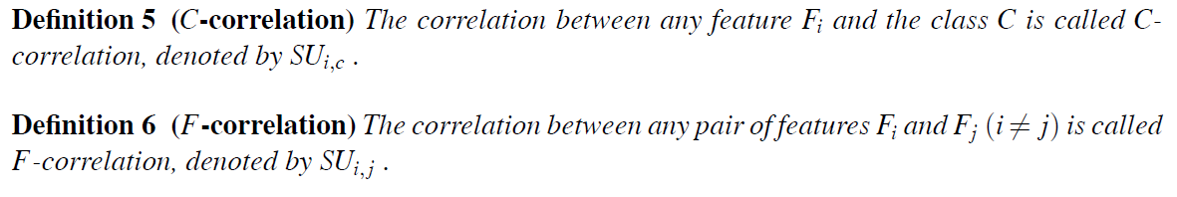
Relevance and redundancy analysis

Slide 9
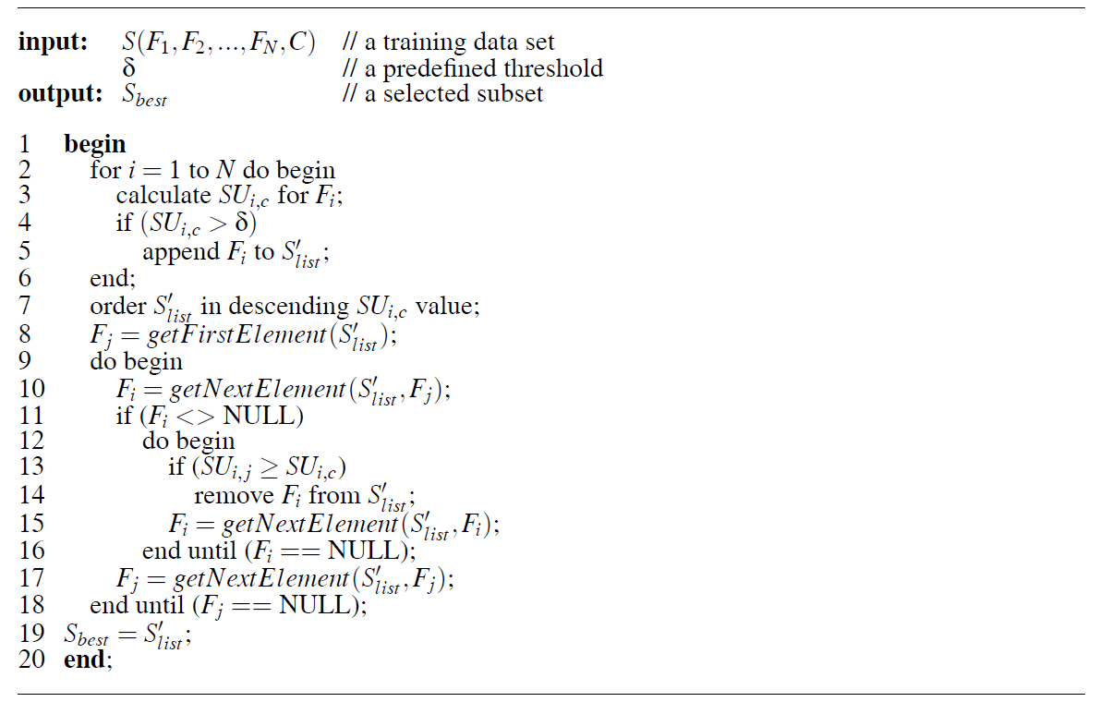
Algorithm

Slide 10
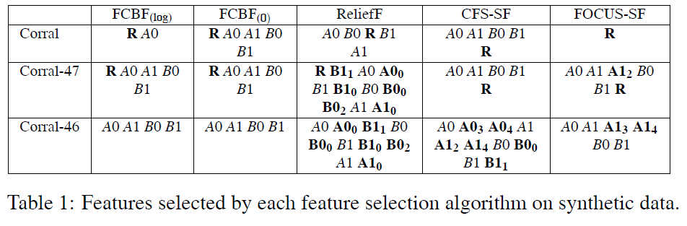
Synthetic data example

Slide 11
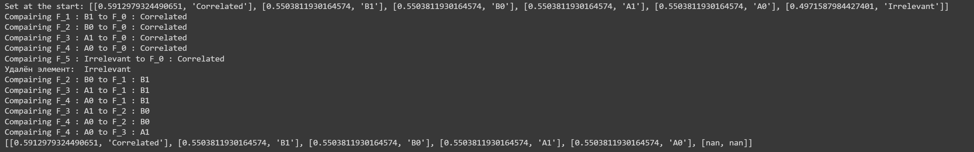

Our result

